Slide 1
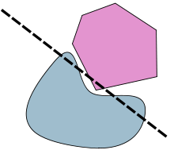
Support Vector Machines
Lars Hadidi, Manuel Herbst

Slide 2
Contents
Classification
Binary Classification
Hyperplanes
Maximal Margin Classifier
Concept
Constrained optimization
Support Vectors
Support Vector Classifier
Non-separable sets
Soft margin
SVC

Slide 3
Binary Classification

Slide 4
Binary Classification
Logistic Regression
k-Nearest Neighbors
Decision Trees
Support Vector Machine
Naive Bayes

Slide 5
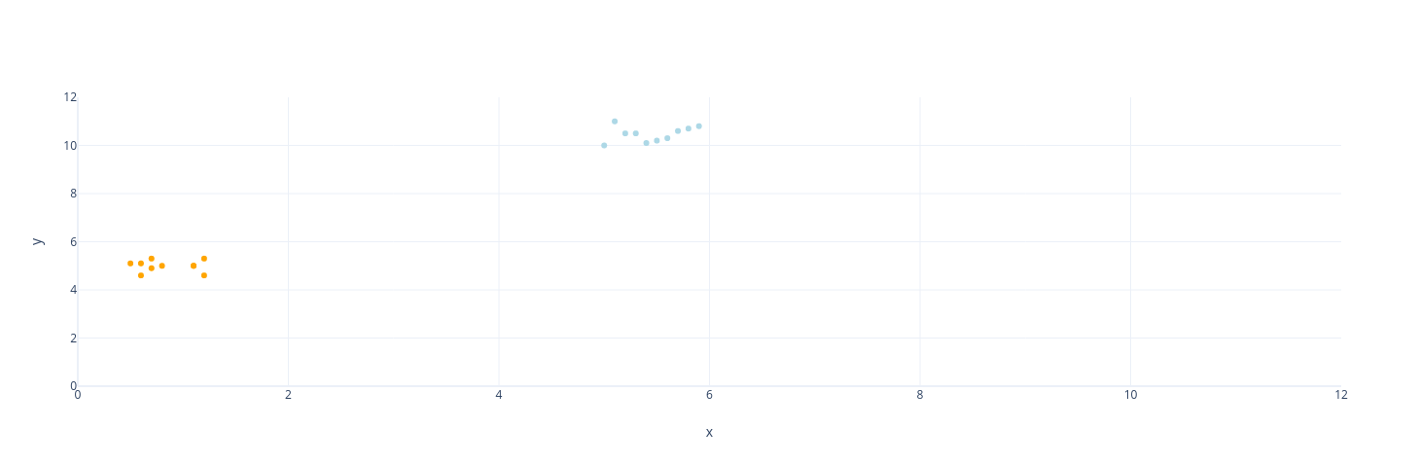
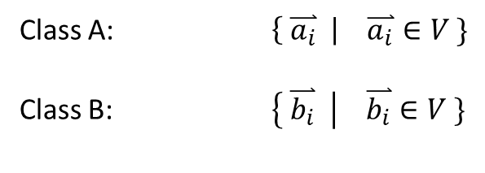

Binary Classification
Class A: $\left\{ \overset{⃑}{a_{i}} \right| \overset{⃑}{a_{i}}∈V \}$
Class B: $\left\{ \overset{⃑}{b_{i}} \right| \overset{⃑}{b_{i}}∈V \}$
$$\dim\left(V\right)=2$$

Slide 6


Binary Classification
Class A: $\left\{ \overset{⃑}{a_{i}} \right| \overset{⃑}{a_{i}}∈V \}$
Class B: $\left\{ \overset{⃑}{b_{i}} \right| \overset{⃑}{b_{i}}∈V \}$
$\dim\left(V\right)=$3

Slide 7
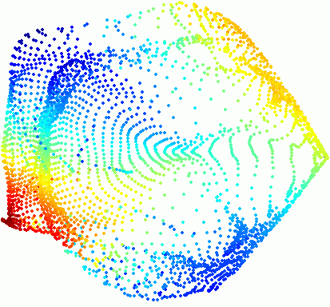

Binary Classification
Class A: $\left\{ \overset{⃑}{a_{i}} \right| \overset{⃑}{a_{i}}∈V \}$
Class B: $\left\{ \overset{⃑}{b_{i}} \right| \overset{⃑}{b_{i}}∈V \}$
$$\dim\left(V\right)=N$$

Slide 8
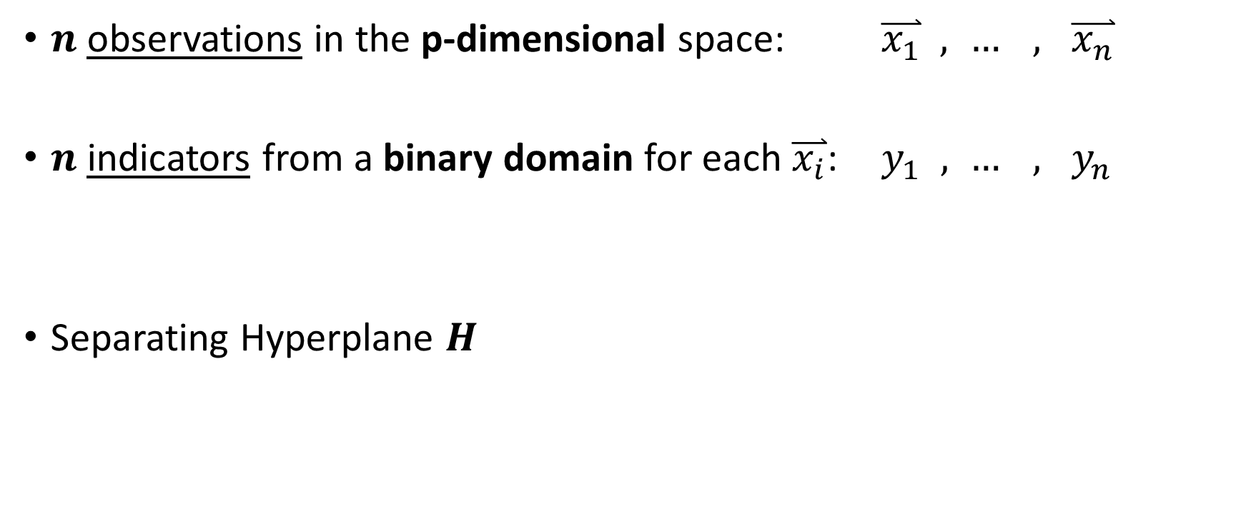
Binary Classification
$n$ observations in the p-dimensional space: $\overset{⃑}{x_{1}} , … , \overset{⃑}{x_{n}}$
$n$ indicators from a binary domain for each $\overset{⃑}{x_{i}}$: $y_{1} , … , y_{n}$
Separating Hyperplane $H$

Slide 9
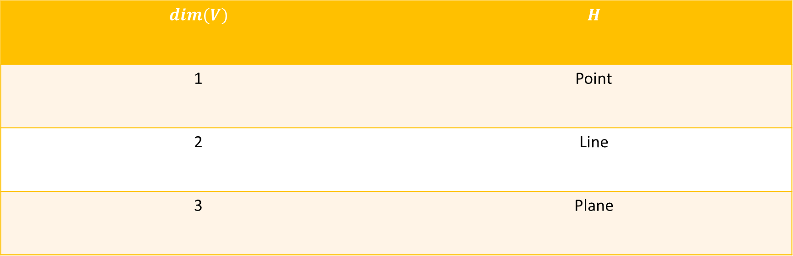

Hyperplane
In a vector space $V$: linear subspace $H$ of codimension 1
$$dim(V)$$ | $$H$$
1 | Point
2 | Line
3 | Plane

Slide 10


Hyperplane
In HSF: $d+\overset{⃑}{X}∙\hat{β}=0$
$$\hat{β}$$

Slide 11
Hyperplane
In HSF: $d+\overset{⃑}{X}∙\hat{β}=0$
Projection
$$\hat{β}$$

Slide 12
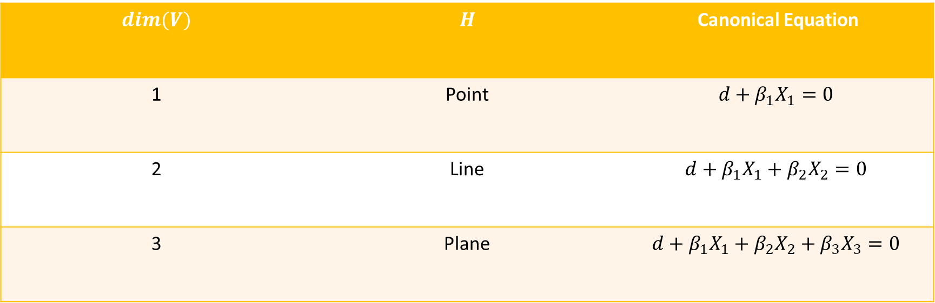
Hyperplane
In a vector space $V$: linear subspace $H$ of codimension 1
$$dim(V)$$ | $$H$$ | Canonical Equation
1 | Point | $$d+β_{1}X_{1}=0$$
2 | Line | $$d+β_{1}X_{1}+β_{2}X_{2}=0$$
3 | Plane | $$d+β_{1}X_{1}+β_{2}X_{2}+β_{3}X_{3}=0$$

Slide 13

Hyperplane
In general, the solution of a single linear equation
$$d+\sum_{j=1}^{p}{β_{j}X_{j}}=0$$

Slide 14

Hyperplane
In general, the solution of a single linear equation
$$d+\sum_{j=1}^{p}{β_{j}X_{j}}>0$$

Slide 15

Hyperplane
In general, the solution of a single linear equation
$$d+\sum_{j=1}^{p}{β_{j}X_{j}}<0$$

Slide 16
Separating Hyperplane

Slide 17

Separating Hyperplane
$$d+\sum_{j=1}^{p}{β_{j}X_{j}}=0$$

Slide 18

Separating Hyperplane
$$d′+\sum_{j=1}^{p}{{β′}_{j}X_{j}}=0$$

Slide 19

Separating Hyperplane
$$d′′+\sum_{j=1}^{p}{{β′′}_{j}X_{j}}=0$$

Slide 20

Separating Hyperplane
Separating hyperplane defined by coefficients $\overset{⃑}{β}$
$$d+\sum_{j=1}^{p}{\hat{β_{j}}X_{j}}=f_{β}\left(\overset{⃑}{X}\right)=0$$
Not unique

Slide 21
Maximal Margin Classifier
Find an optimal separating hyperplane
$$f_{β}\left(\overset{⃑}{X}\right)=0$$

Slide 22

Maximal Margin Classifier
$$M_{1}$$

Slide 23


Maximal Margin Classifier
$$M_{1}<M_{2}$$
$$M_{2}$$

Slide 24


Maximal Margin Classifier
$$M_{1}<M_{2}<M_{3}$$
$$M_{3}$$

Slide 25








Maximal Margin Classifier
Find $\overset{⃑}{β},d$ such that $M$ is maximal
$$\max_{d,\overset{⃑}{β},M}{M}$$
$${\left\|\overset{⃑}{β}\right\|}_{2}^{2}=1$$
$$∀i: y_{i} f_{\overset{⃑}{β}}\left(\overset{⃑}{x_{i}}\right) ≥ M$$
$$y_{i} ε \{−1,+1\}$$
$$±$$
$sgn⁡(f_{\overset{⃑}{β}}$)

Slide 26

Maximal Margin Classifier
Find $\overset{⃑}{β},d$ such that $M$ is maximal
$$\max_{d,\overset{⃑}{β},M}{M}$$
$${\left\|\overset{⃑}{β}\right\|}_{2}^{2}=1$$
$$∀i: y_{i} f_{\overset{⃑}{β}}\left(\overset{⃑}{x_{i}}\right) ≥ M$$
→ $\left|f_{\overset{⃑}{β}}\left(\overset{⃑}{x_{i}}\right)\right|= {distance}_{⊥}(\overset{⃑}{x_{i}},H)$
$$y_{i} ε \{−1,+1\}$$
$$±$$
$sgn⁡(f_{\overset{⃑}{β}}$)

Slide 27


Maximal Margin Classifier
Find $\overset{⃑}{β},d$ such that $M$ is maximal
$$\max_{d,\overset{⃑}{β},M}{M}$$
$${\left\|\overset{⃑}{β}\right\|}_{2}^{2}=1$$
$$∀i: y_{i} f_{\overset{⃑}{β}}\left(\overset{⃑}{x_{i}}\right) ≥ M$$
QP Solver
→ $\left|f_{\overset{⃑}{β}}\left(\overset{⃑}{x_{i}}\right)\right|= {distance}_{⊥}(\overset{⃑}{x_{i}},H)$

Slide 28



Maximal Margin Classifier
Find $\overset{⃑}{β},d$ such that $M$ is maximal
$$\max_{d,\overset{⃑}{β},M}{M}$$
$${\left\|\overset{⃑}{β}\right\|}_{2}^{2}=1$$
$$∀i: y_{i} f_{\overset{⃑}{β}}\left(\overset{⃑}{x_{i}}\right) ≥ M$$
QP Solver
Conjugate gradient method
Lagrangian Multipliers
$$\{\overset{⃑}{β},d, M\}$$

Slide 29
Support Vectors
support vectors

Slide 30
Support Vectors

Slide 31
Support Vectors
maximal margin
support vectors
optimal separating hyperplane

Slide 32
Non-seaparable sets

Slide 33
Soft Margin

Slide 34
Soft Margin
Hard Margin | Soft Margin
sets must be separable | works with non-separable sets
easily overfits data
margin can be very small

Slide 35
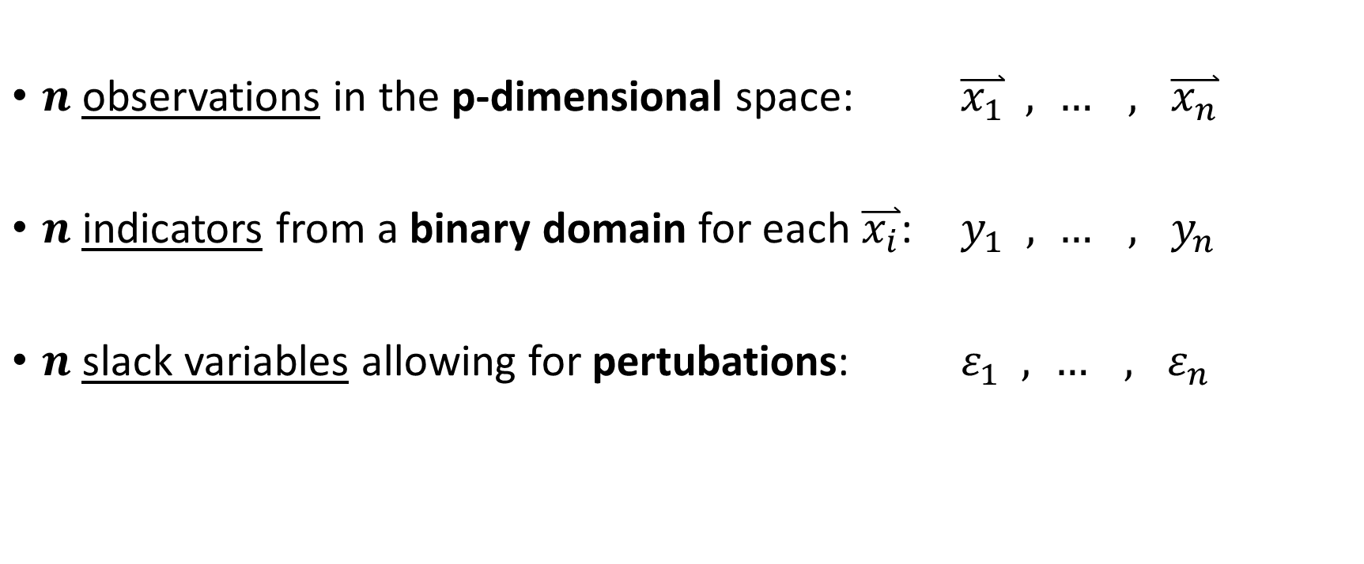
Support Vector Classifier
$n$ observations in the p-dimensional space: $\overset{⃑}{x_{1}} , … , \overset{⃑}{x_{n}}$
$n$ indicators from a binary domain for each $\overset{⃑}{x_{i}}$: $y_{1} , … , y_{n}$
$n$ slack variables allowing for pertubations: $ε_{1} , … , ε_{n}$

Slide 36
Support Vector Classifier
Hard Margin Classification → Soft Margin Classification
$$\max_{d,\overset{⃑}{β},M}{M}$$
$${\left\|\overset{⃑}{β}\right\|}_{2}^{2}=1$$
$$∀i: y_{i} f_{\overset{⃑}{β}}\left(\overset{⃑}{x_{i}}\right) ≥ M$$

Slide 37

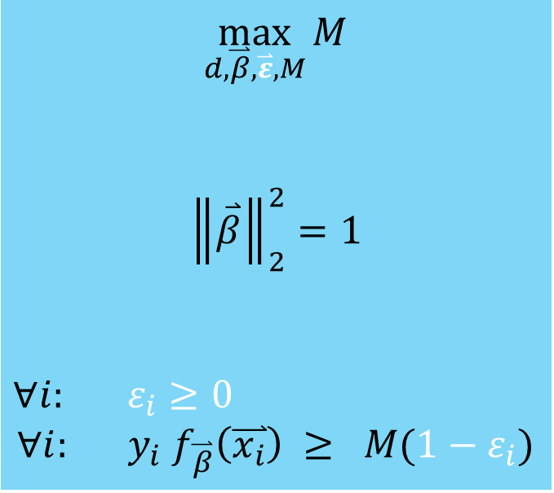
Support Vector Classifier
$$\max_{d,\overset{⃑}{β},\overset{⃑}{ε},M}{M}$$
$${\left\|\overset{⃑}{β}\right\|}_{2}^{2}=1$$
$∀i:$ $ε_{i}≥0$
$$∀i: y_{i} f_{\overset{⃑}{β}}\left(\overset{⃑}{x_{i}}\right) ≥ M(1−ε_{i})$$
slack variables
$0=ε_{i}$
$0<ε_{i}≤1$
$1<$ $ε_{i}$
respect margin
margin pertubation
hyperplane crossing

Slide 38
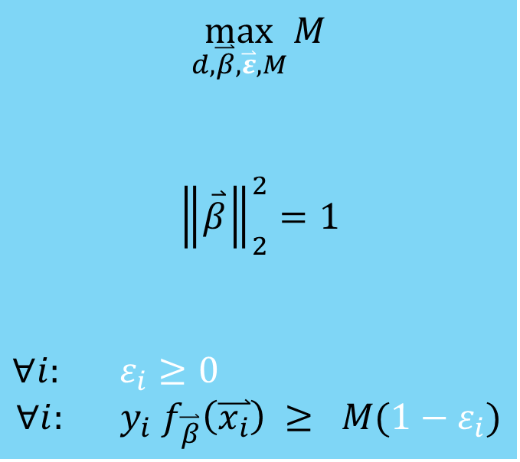
Support Vector Classifier
$$\max_{d,\overset{⃑}{β},\overset{⃑}{ε},M}{M}$$
$${\left\|\overset{⃑}{β}\right\|}_{2}^{2}=1$$
$∀i:$ $ε_{i}≥0$
$$∀i: y_{i} f_{\overset{⃑}{β}}\left(\overset{⃑}{x_{i}}\right) ≥ M(1−ε_{i})$$
Constrain amount of margin- and hyperplane-violations

Slide 39
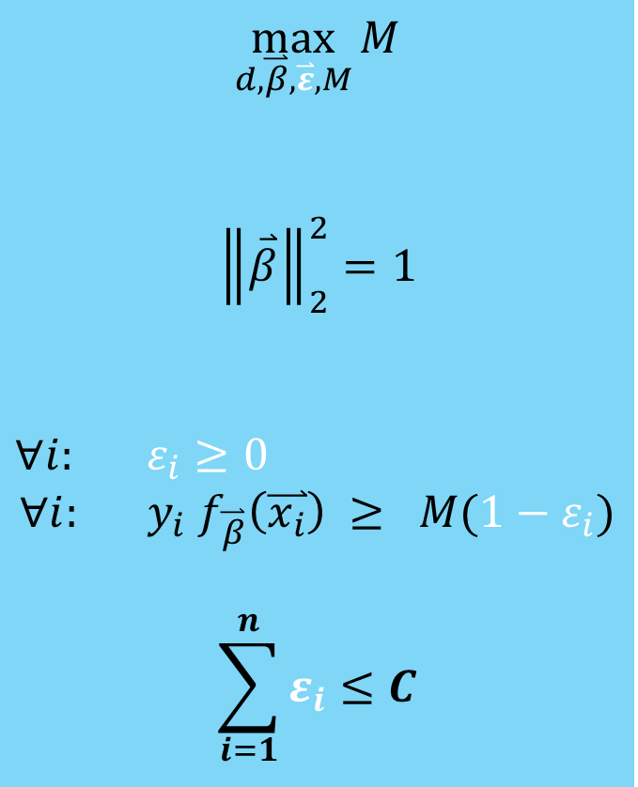
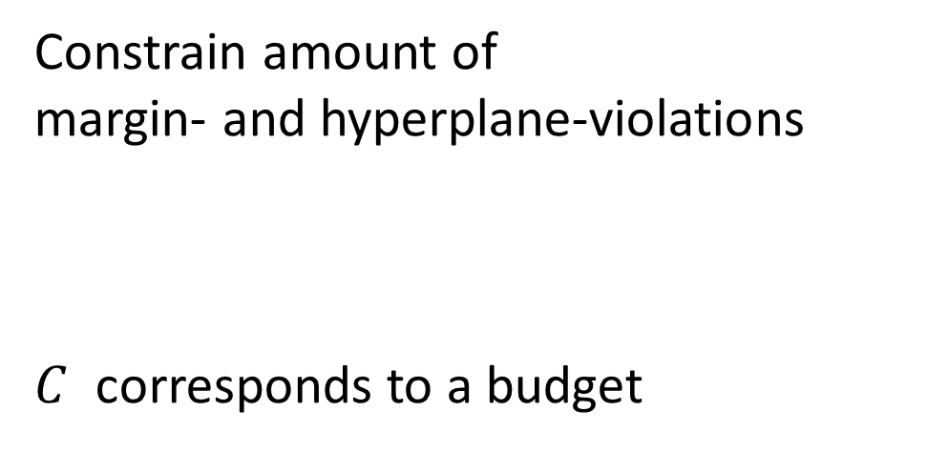
Support Vector Classifier
$$\max_{d,\overset{⃑}{β},\overset{⃑}{ε},M}{M}$$
$${\left\|\overset{⃑}{β}\right\|}_{2}^{2}=1$$
$∀i:$ $ε_{i}≥0$
$$∀i: y_{i} f_{\overset{⃑}{β}}\left(\overset{⃑}{x_{i}}\right) ≥ M(1−ε_{i})$$
$$\sum_{i=1}^{n}{ε_{i}≤C}$$
Constrain amount of margin- and hyperplane-violations
$C$ corresponds to a budget

Slide 40
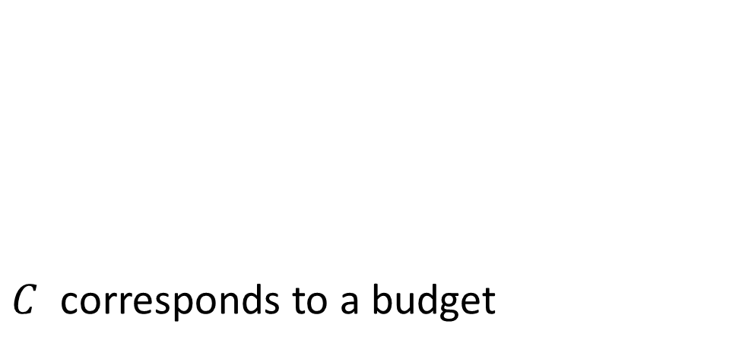
Support Vector Classifier
$$\max_{d,\overset{⃑}{β},\overset{⃑}{ε},M}{M}$$
$${\left\|\overset{⃑}{β}\right\|}_{2}^{2}=1$$
$∀i:$ $ε_{i}≥0$
$$∀i: y_{i} f_{\overset{⃑}{β}}\left(\overset{⃑}{x_{i}}\right) ≥ M(1−ε_{i})$$
$$\sum_{i=1}^{n}{ε_{i}≤C}$$
$C$ corresponds to a budget
COST
respect margin
margin pertubation
hyperplane crossing

Slide 41
Support Vector Classifier
support vectors

Slide 42
Support Vector Classifier
Hard Margin | Soft Margin
sets must be separable | works with non-separable sets
easily overfits data | less variance
margin can be very small

Slide 43
Support Vector Classifier
Hard Margin | Soft Margin
sets must be separable | works with non-separable sets
easily overfits data | less variance
margin can be very small | allows violations

Slide 44
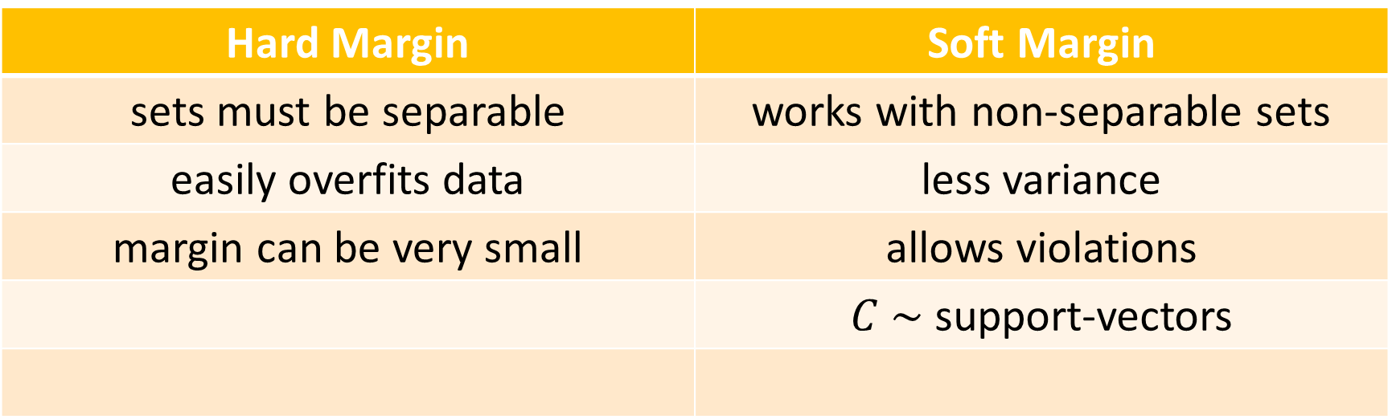
Support Vector Classifier
Hard Margin | Soft Margin
sets must be separable | works with non-separable sets
easily overfits data | less variance
margin can be very small | allows violations
 | $C \sim$support-vectors

Slide 45
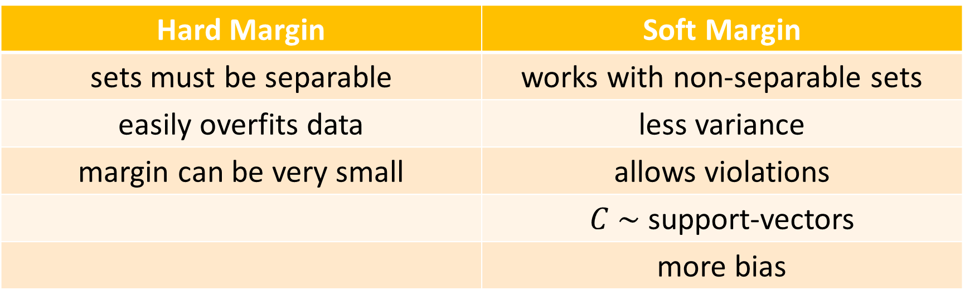
Support Vector Classifier
Hard Margin | Soft Margin
sets must be separable | works with non-separable sets
easily overfits data | less variance
margin can be very small | allows violations
 | $C \sim$support-vectors
 | more bias

Slide 46
Non-linearly separable sets

